Slide 1
Human Islet isolation Technical Q&A FACILITATORS Robert McCarthy, United States appakalai natarajan balamurugan, United States Doug O’gorman, Canada
Session sponsored by

Slide 2
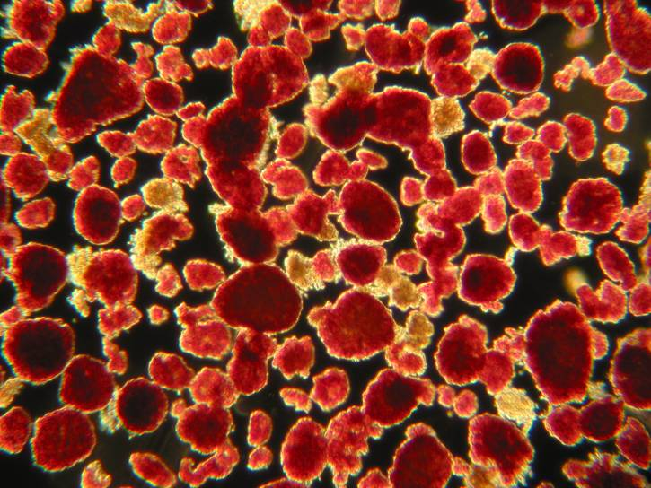
Process Map for Isolating Human Islets
1.0 Organ Procurement Transport
2.0 Tissue Digest
Islet Purification
3.0 Islet Characteristic
Release Criteria
4.0 Islet Shipment
Infusion for tx
Sub Steps….......…slide 3
Questions…….......slide 7

Slide 3
Process Map for Isolating Human Islets
1.0 Organ Procurement Transport
2.0 Tissue Digest
Islet Purification
3.0 Islet Characteristic
Release Criteria
4.0 Islet Shipment
Infusion for tx
1.1
1.2
1.3
Procure organ
Assess organ,
Donor selection,
Prepare transport
Transport organ

Slide 4
Process Map for Isolating Human Islets
1.0 Organ Procurement Transport
2.0 Tissue Digest
Islet Purification
3.0 Islet Characteristic
Release Criteria
4.0 Islet Shipment
Infusion for tx
2.1
2.2
2.3
Prepare organ, Infuse enzyme solution
Digest organ in vessel
Monitor digestion, Stop digestion
2.4
2.5
2.6
Wash & incubate islets
Islet purification
Wash & culture islets

Slide 5
Process Map for Isolating Human Islets
1.0 Organ Procurement Transport
2.0 Tissue Digest
Islet Purification
3.0 Islet Characteristic
Release Criteria
4.0 Islet Shipment
Infusion for tx
3.1
3.2
3.3
Islet yield, viability, purity
Functional assessment
Release criteria

Slide 6
Process Map for Isolating Human Islets
1.0 Organ Procurement Transport
2.0 Tissue Digest
Islet Purification
3.0 Islet Characteristic
Release Criteria
4.0 Islet Shipment
Infusion for tx
4.1
4.2
4.3
Islet transport solution & transport device
Patient prep to improve engraftment
Islet infusion

Slide 7
Q&A islet isolation from organ donors for islet allograft transplantation FACILITATOR DOUG O’GORMAN, Canada

Slide 8
Clinical Islet Laboratory Alberta Health Services / University of Alberta
Questions?
What donor factors are most commonly associated with improved outcomes?
Does a certain young donor type lead to improved isolation success?
Is there an enzymatic solution to improving younger donor islet isolations?
Does variability of outcomes exist between different enzyme lots and types?
How much variability exists using manual counting?
Design
All clinical isolations using our standard of care protocols and GMP enzymes (n=866) were included in this analysis.
Primary measure for outcome was pre-purification IE and or the calculated pre-purification percentage of trapped islets
Data Source
Study data were collected and managed using REDCap electronic data capture tools hosted at Alberta Health Services.

Slide 9
Questions
1.2
How does donor selection influence the isolation process and islet yield outcomes?
Donor selection
Based on 866 isolations at a single center the following observations can be made:
Donor weight is the strongest indicator of higher islet yields. BMI to a lesser extent is associated with increased islet yields.
Increased donor weight for every donor age quartile led to higher islet yields.
Donors in the lowest age quartile have the highest islet yield at pre-purification yet have the lowest post purification yield because of the increased fraction of trapped islets.
Cold ischemia time does not appear to influence islet yields.
Allogeneic donor types have comparable islet yields regardless of whether they are DBD or DCD however DCD donors with long cold ischemia times have inferior outcomes.
Cause of Death (CVA vs Non CVA) may not strongly influence islet yields.

Slide 10
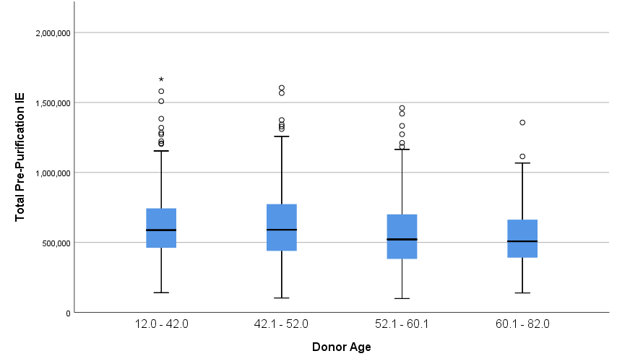
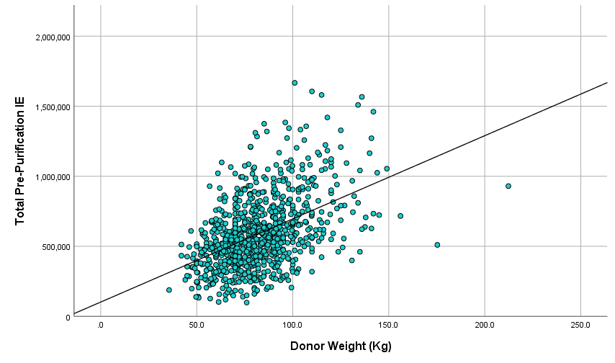
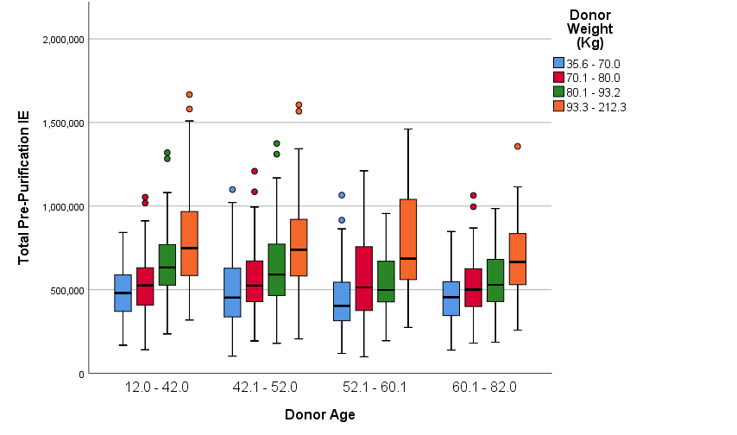
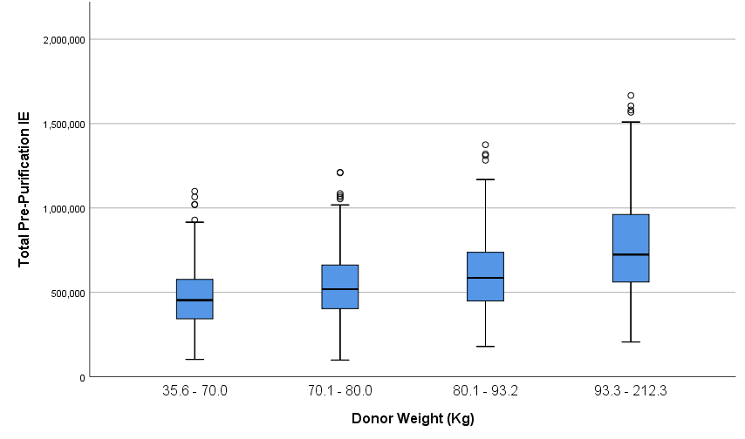
Questions
1.2
How does donor selection influence the isolation process and outcome?
Donor selection
Donor Age and Weight

Slide 11
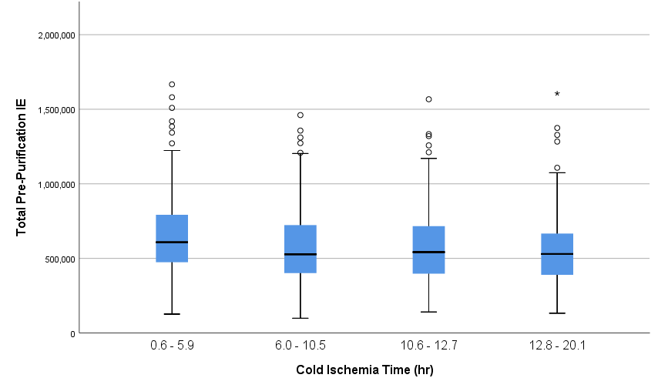
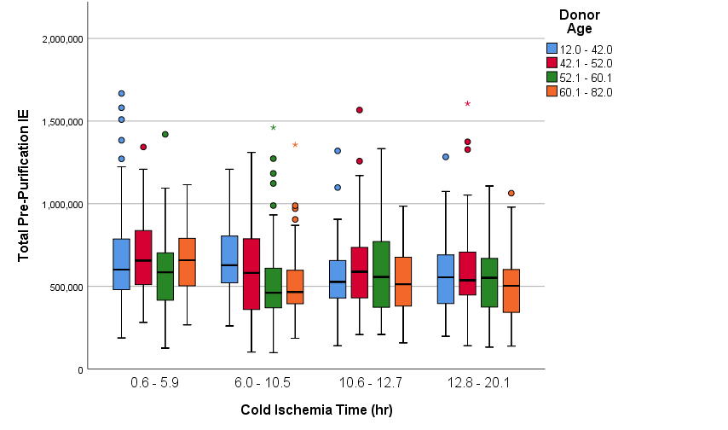
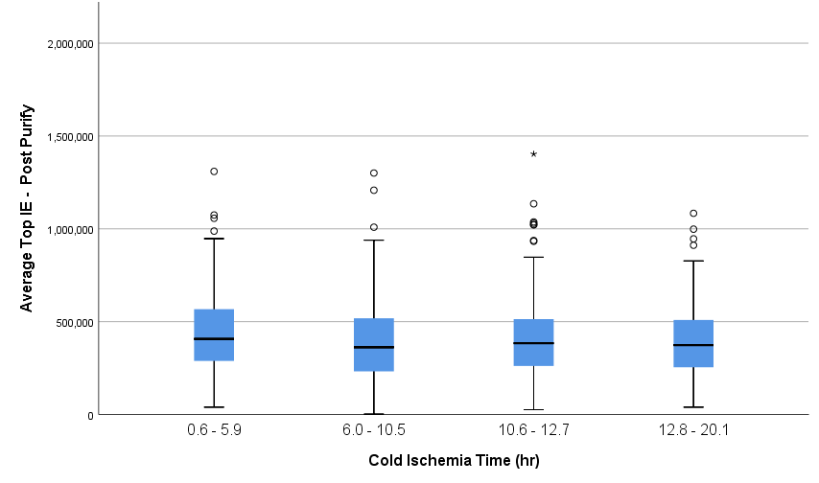
Questions
1.2
How does donor selection influence the isolation process and outcome?
Donor selection
Cold Ischemia Time

Slide 12
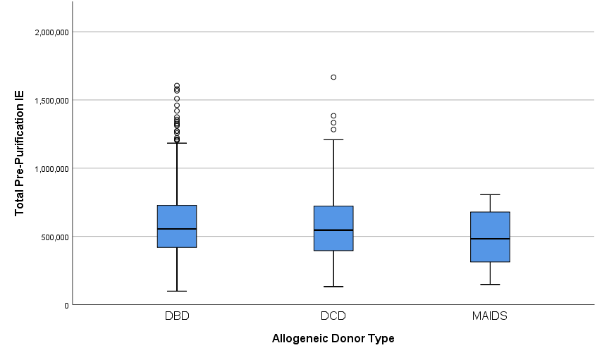
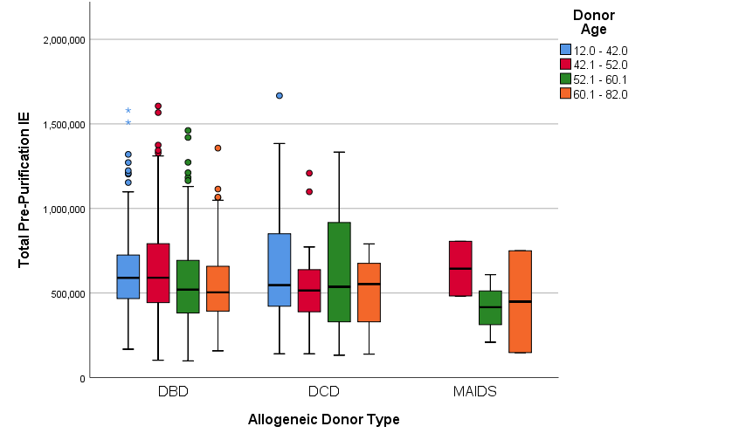
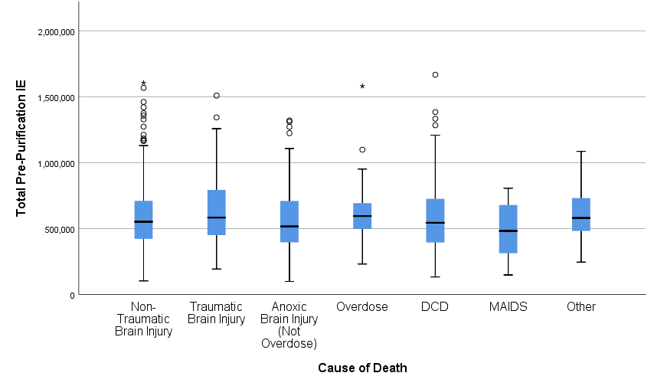
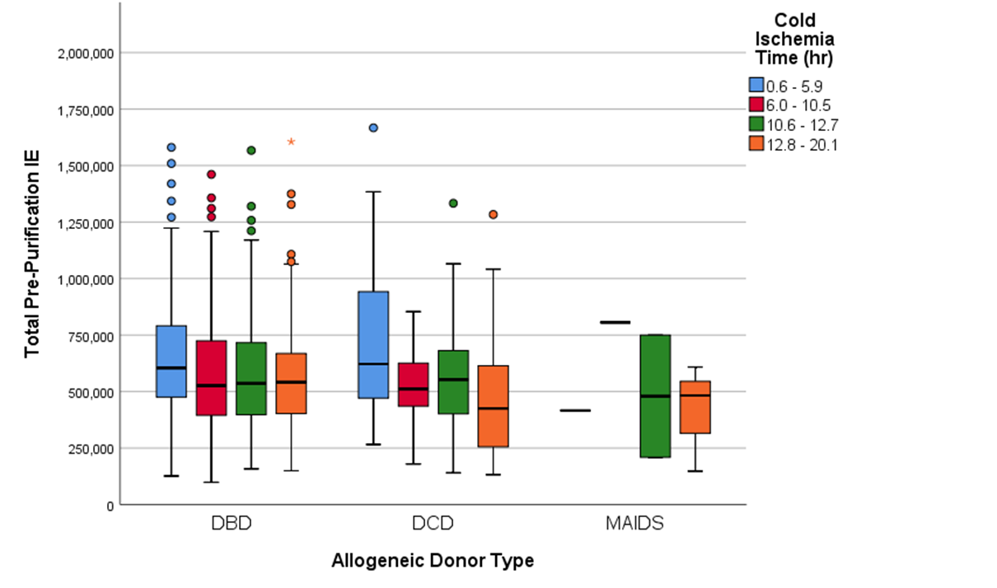
Questions
1.2
How does donor selection influence the isolation process and outcome?
Donor selection
Donor Type and Cause of Death

Slide 13
Questions
1.2
Are there donor characteristics that lead to improved outcomes in islet isolations from young donors (<42 yr.)?
Donor selection
Observations:
When assessing younger donors (<42ys old) selecting donors that are >33y.o., >88.5Kg or have a BMI >29.0 may lead to a higher percentage of free islets.
Possible Enhancements:
Optimizing enzyme dosing and type for young donors (Increased thermolysin dose, reduced collagenase dose)
Alternative proteolytic enzymes (e.g. BP Protease)
Would using a 2-phase digestion improve percentage of free islets with out over exposing islets to proteolytic enzymes?
Increased distension time, reduced mechanical dissociation, increased enzyme concentration

Slide 14
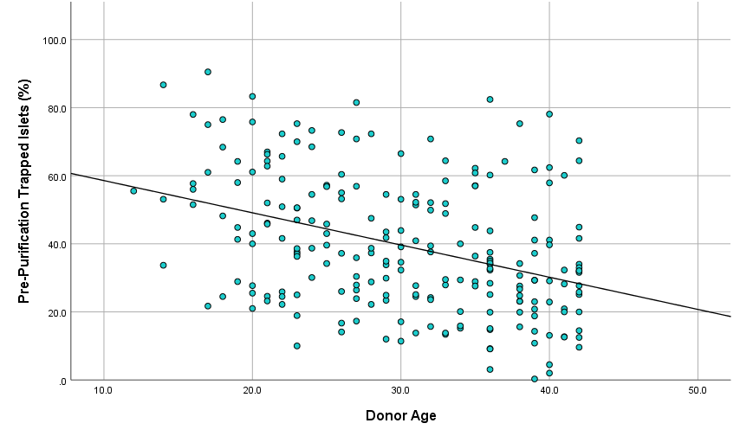
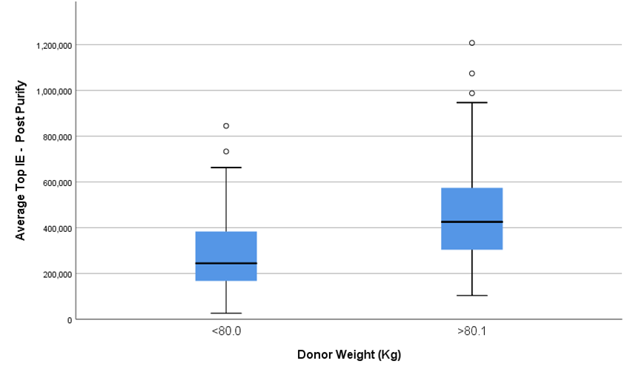
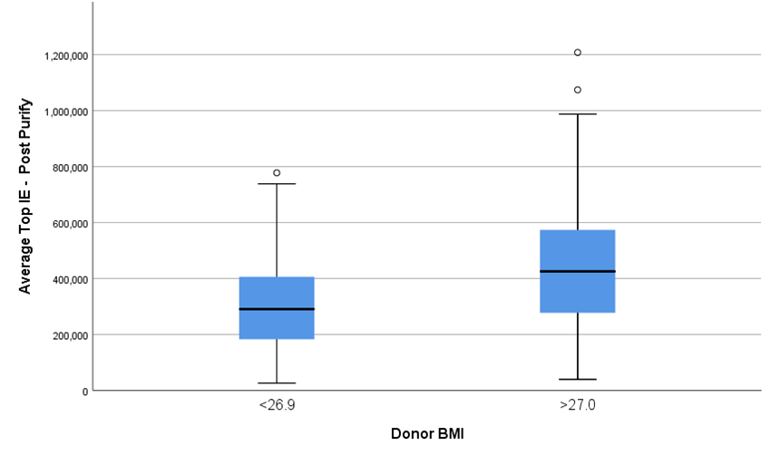
Questions
1.2
Are there donor characteristics that lead to improved outcomes in islet isolations from young donors (<42 yr.)?
Donor selection

Slide 15
Questions
1.2
Are there donor characteristics that lead to improved outcomes in islet isolations from young donors (<42 yr.)?
Donor selection
Variable | <30% Trapped (n=86) | >30% Trapped (n=135) | p
Age | 32.9 | 28.5 | <0.001
Weight | 88.5 | 82.1 | 0.045
BMI | 29.3 | 26.5 | 0.003
Pancreas Weight (g) | 90.7 | 88.7 | 0.486
Collagenase Dose (U) | 2,512 | 2,366 | 0.046
Collagenase Dose (U/g) | 28.6 | 27.6 | 0.296
Digestion Time (min) | 15.5 | 16.7 | 0.038
Pre-Purification IE (x10³) | 716 | 567 | <0.001
Pre-Purify IE/g | 7,899 | 6,455 | <0.001
Purification Recovery (%) | 71.1 | 51.8 | <0.001
Post Purification IE (x10³) | 502 | 294 | <0.001
Post-Purify IPN (x10³) | 436 | 216 | <0.001
Post Purification Purity | 52.7 | 37.4 | <0.001
Post-Purify Islet Index | 1.16 | 1.39 | <0.001

Slide 16
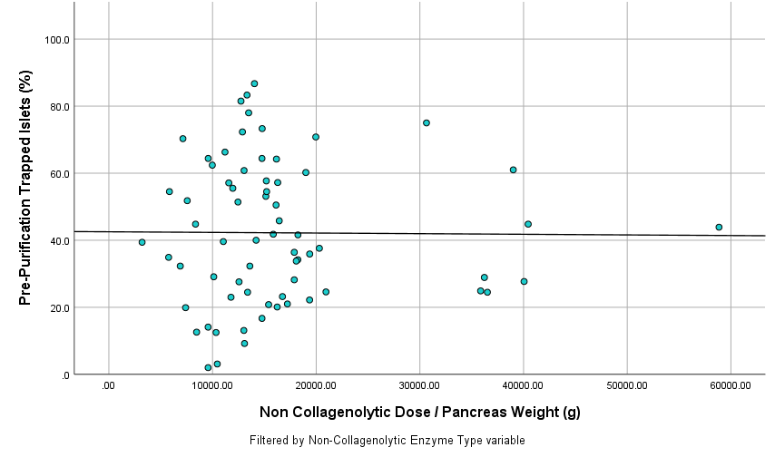
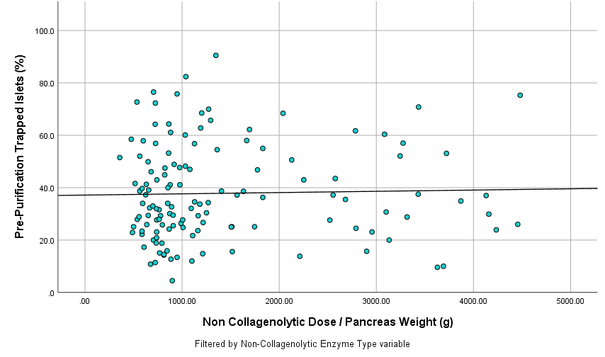
Questions
2.1
Is there an enzymatic solution to improving success rates of younger donors (<42yr.)?
Infuse enzyme solution: Enzyme dosing
VitaCyte Collagenase HA & Thermolysin
Roche MTF
Observations:
Increasing thermolysin dose 3-4 fold does not appear to dramatically alter the percentage of free islets (data is preliminary).
Increasing digestion time will not lead to more free islets

Slide 17
Questions
2.1
Does variability exist between enzyme lots?
Infuse enzyme solution: Enzyme dosing
Observations:
Statistically islet yields do not differ from lot to lot regardless of the enzyme type used.
Wunsch assay is likely not the best measure of enzyme activity based on CII specificity.
Use of Wunsch assay to dose enzyme likely not optimal.
Development of a harmonized proteolytic activity assay would benefit optimization of enzyme selection and dosing.

Slide 18
Questions
3.1
How much variability exists using manual counting?
Islet yield, viability, purity

Slide 19
Questions
3.1
How much variability exists using manual counting?
Islet yield, viability, purity

Slide 20
Questions
3.1
How much variability exists using manual counting?
Islet yield, viability, purity
Observations:
Manual counting can be considered a reliable method for quantifying islet masses provided the following key factors.
Experienced staff who perform counts routinely.
Independent counts performed in duplicate.
Variation between staff counts has decreased over time.

Slide 21
Q&A islet isolation from chronic Pancreatitis patients FACILITATOR APPAKALAI NATARAJAN BALAMURUGAN, United States

Slide 22
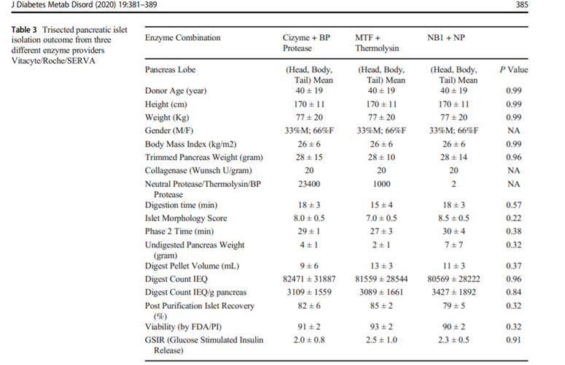
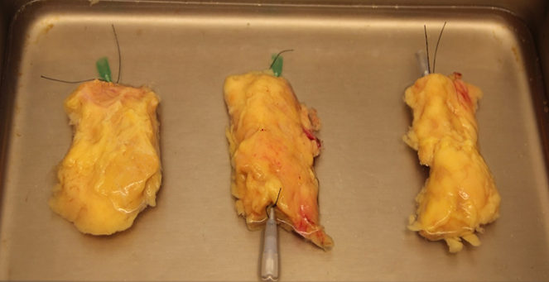
Questions
2.1
What protease is better to use in islet auto-transplantation?
Prepare organ, Infuse enzyme solution
Purified Clostridium histolyticum collagenase is supplied by three main companies that can be combined with three different proteases: Thermolysin, BP Protease (BPP-Dispase equivalent), or NB Protease (NB-C. histolyticum neutral protease). Islets isolated from split lobe experiments (human pancreas split into 3 lobes and each digested with one enzyme formulation) showed BPP and NB did not damage islets whereas Thermolysin did. Carefully monitor switch time when using Thermolysin.

Slide 23
Questions
2.1
Is it necessary to use pressure controlled pump perfusion for enzyme injection? How long can enzyme be injected into fibrotic pancreas?
Prepare organ, Infuse enzyme solution
Hand syringe injection through pancreatic duct or parenchymal injection can be used for fibrotic pancreas. When using a semiautomated perfusion system be vigilant to maintain the pump speed and flow rate above 30mL/min. A ductal occlusion or misplaced cannula can obstruct the flow of liquid, increasing the pressure and slowing the automated pump. However, enzyme injected at a low flow rate, even with a normal pressure reading, would result in an ineffective distension.
Prolonging enzyme injection to 30-40 min especially parenchymal injection stage is important. Standard 10-15min enzyme distention duration will not be sufficient. In some cases the extent of parenchymal fibrosis is so high that ductal enzyme
perfusion is ineffective at delivering enzyme to the entire body of the pancreas. In these cases, interstitial perfusion can be performed by repeated manual injections of cold enzyme solution into the tissue with a needle and syringe.

Slide 24
Questions
2.1
How to remove calcium deposits in pancreatic digest?
Prepare organ, Infuse enzyme solution
In some instances of chronic pancreatitis, calcification deposits, up to 3 mm in diameter, may be observed in the collection conical tubes and should be removed before centrifugation. These deposits are much denser and larger than the observable digest tissue and can be mechanically separated by pipet aspiration. The calcifications should be gathered into a separate 250 mL conical where they can be rinsed with recombination solution to rescue any islets aspirated with the deposits.

Slide 25
Questions
2.2
Will prolonging enzyme recirculation improve islet yield for severely fibrotic pancreas?
Digest organ in vessel
Yes, prolonging enzyme recirculation will help to digest the undigested portion of the pancreas. If very little digestion is observed in Ricordi chamber after 30 min of digestion phase, yields may increase by using an enzyme recirculation protocol. This procedural variation involves the collection of free islets from the recirculating system early after release. The free islets are pelleted by a quick centrifugation step and transferred into fresh, cold media in the recombination container. The supernatant, containing active enzyme, is recycled back into the digestion system, which maintains the effective enzyme dose for the undigested tissue remaining in the Ricordi chamber This recirculation can be repeated until nearly all tissue mass has dispersed or healthy islets are no longer apparent in the digestion samples. For additional details see https://pubmed.ncbi.nlm.nih.gov/12919094/.

Slide 26
Questions
2.3
What is the best way to inhibit collagenase and protease activity at the end of the digestion procedure?
Monitor digestion, Stop digestion
Protease Activity: 1-2% human AB serum will inhibit nearly all neutral proteases (see JA Kerr-Conte et al https://pubmed.ncbi.nlm.nih.gov/20098354/ ). Also see a VitaCyte poster https://www.vitacyte.com/app/uploads/2021/10/2013-CTS-Poster-Final-scaled.jpg. Alpha 1 anti-trypsin will rapidly inhibit serine proteases that are released from damaged acinar cells (G Loganthan et al https://pubmed.ncbi.nlm.nih.gov/22089666/) increasing the recovery of islet after overnight culture.
Collagenase Activity: C. histolyticum collagenase activity is not inhibited by serum (see hyperlink to VitaCyte poster above). Incubating the cells at cold temperature will stop collagenase degradation activity but the collagenase tightly binds to collagen at this temperature. Collagenase will likely be released from cells when incubated at room temperature or above.

Slide 27
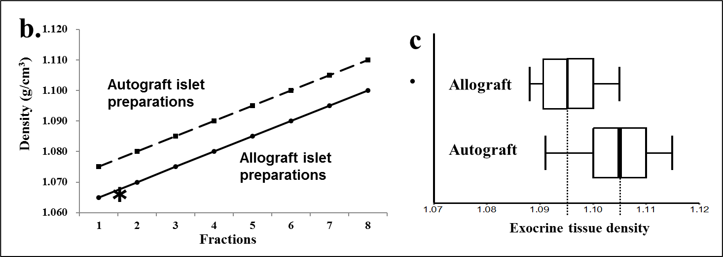
Questions
2.5
What density should be used for islet purification?
Islet purification
There is a difference in the exocrine density for living, chronic pancreatitis (CP) donors (mean 1.105, range 1.085–1.115 g/cm3), versus brain-dead donors (mean 1.095, range 1.080–1.105 g/cm3). To compensate for this effect, we prefer to use a denser gradient range for CP islet isolations, pushing the islets out of the COBE bag and into the collection fractions.
Following purification, CP islets will be found in all 12 collection fractions while donor islets will be primarily settled into the first 8, less dense layers. We adjust our standard gradient range to 1.065–1.115 g/cm3. This approach reduces the exocrine mass, and avoid islet cell loss, but purity level may not be high. See https://pubmed.ncbi.nlm.nih.gov/21169878/.

Slide 28
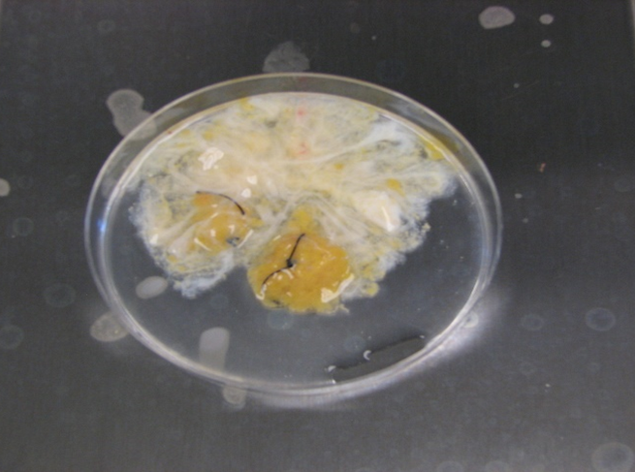
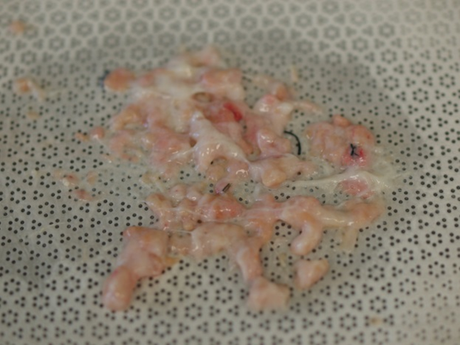
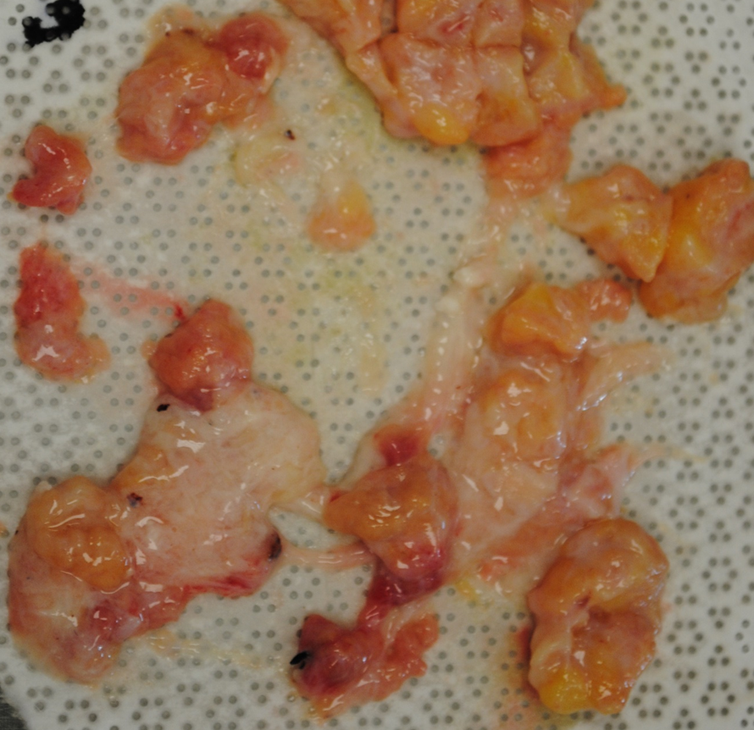
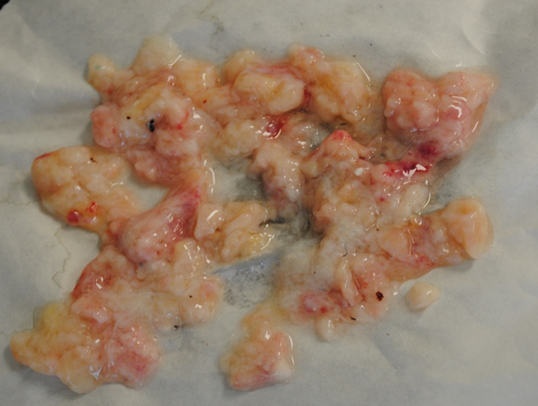
Questions
3.1
How to define islet isolation success in islet auto-transplantation procedure?
Islet yield, viability, purity
At the end of digestion step, if the undigested tissue mass in Ricordi chamber is <15-20 %, it is considered as success.
In order to achieve less undigested tissue mass especially in severely fibrotic pancreas, care should be taken during enzyme dosing and enzyme distention step (ductal or parenchymal injection). Temperature, circulation speed, enzyme dose, apparatus setup, and/or the level of mechanical shaking can all be used to accommodate the inherent variation in pancreatic tissue condition caused by different disease pathologies. An understanding of how these digestion parameters affect the rate and quality of tissue dissociation is essential to minimize the amount of undigested tissue left in the Ricordi chamber and to maximize the number and quality of liberated islets obtained.
Minimal Undigestion
Mild Undigestion
Medium Undigestion
High Undigestion

